Slide 1
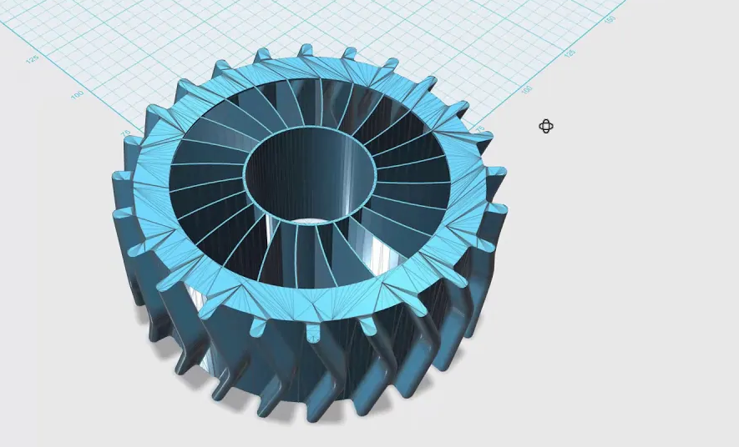
CAD program

Slide 2
Most of the students don't know what is it CAD program, so the first teacher step to introduce the user interface and the capabilities of the CAD program
The primary window of the user interface

Slide 3
The CAD program provides
Design the detail
Design the assembly unit
Making a working drawing of the part
Open an existing project
Open a helper
Open a user forum or service area
After selecting the part to design, you will be taken to the next user interface, where you can now carry out the design work you want.

Slide 4
The design is possible in three planes: front, top and right
At the beginning of our learning, we only need the first two areas for design: sketch and features
Solidworks Design Interface

Slide 5
Sketch area
Sketch area are used for sketching parts, and geometric shapes, defining dimensions, selecting line types, and line intersections, deleting, copying, moving, multiplying, and otherwise editing the outline or other parameters of the part you are drawing.

Slide 6
Sketch
Sketch of the detail

Slide 7
Features area
In the features area we can already create a 3d shape from the sketch, which becomes similar to the shape of the desired part. Here we can not only stretch, rotate, join, cut, and round the part, but there are many other options to modify the part

Slide 8
Features
3D detail from a previously drawn sketch

Slide 9
Designed detail / 3D printing
Save the file in the required format (the printer we use supports STL format)
2. In Solidworks, select: Files -> save as, in the menu that appears, select the file type STL and click the save icon. The program will automatically format the part and prepare it for printing.
Following the printer manufacturer's instructions, we upload the file to the printer software. Select the appropriate parameters: position relative to the table, print material, speed, layer thickness and other parameters. Press the start button and wait for the results.

